Slide 1
Qustion 4
By
Jamil Rayhan
18CSE061

Slide 2
question
Design of a combinational circuit that converts excess-3 code to BCD with external gates.

Slide 3
Truth table for code conversion (BCD to Excess-3)
Excess-3 code |  |  |  | BCD
A | B | C | D | W | X | Y | Z
0 | 0 | 1 | 1 | 0 | 0 | 0 | 0
0 | 1 | 0 | 0 | 0 | 0 | 0 | 1
0 | 1 | 0 | 1 | 0 | 0 | 1 | 0
0 | 1 | 1 | 0 | 0 | 0 | 1 | 1
0 | 1 | 1 | 1 | 0 | 1 | 0 | 0
1 | 0 | 0 | 0 | 0 | 1 | 0 | 1
1 | 0 | 0 | 1 | 0 | 1 | 1 | 0
1 | 0 | 1 | 0 | 0 | 1 | 1 | 1
1 | 0 | 1 | 1 | 1 | 0 | 0 | 0
1 | 1 | 0 | 0 | 1 | 0 | 0 | 1

Slide 4
K-map for W
AB\CD | 00 | 01 | 11 | 10
00 | X | X | 0 | X
01 | 0 | 0 | 0 | 0
11 | 1 | X | X | X
10 | 0 | 0 | 1 | 0
W=AB+ACD

Slide 5
K-map for x
AB\CD | 00 | 01 | 11 | 10
00 | X | X | 0 | X
01 | 0 | 0 | 1 | 0
11 | 0 | X | X | X
10 | 1 | 1 | 0 | 1
X=BCD+B’C’+B’D’

Slide 6
K-map for y
AB\CD | 00 | 01 | 11 | 10
00 | X | X | 0 | X
01 | 0 | 1 | 0 | 1
11 | 0 | X | X | X
10 | 0 | 1 | 0 | 1
Y=C’D+CD’

Slide 7
K-Map for z
AB\CD | 00 | 01 | 11 | 10
00 | X | X | 0 | X
01 | 1 | 0 | 0 | 1
11 | 1 | X | X | X
10 | 1 | 0 | 0 | 1
Z= D’

Slide 8
After solving k-map:-
W= AB+ACD
X= BCD+B’C’+B’D’
Y=C’D+CD’
Z= D’

Slide 9
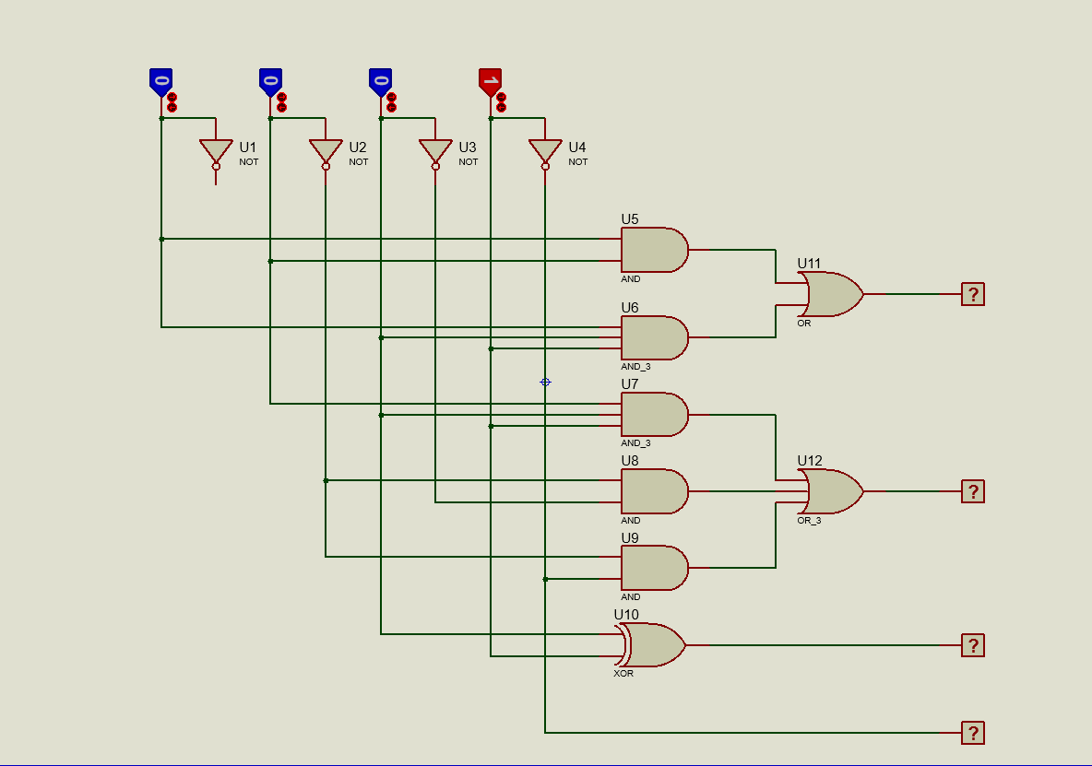
Circuit Diagram
A
B
C
D
W
X
Y
Z

Slide 10
Thank you

